Slide 1
HOSPITAL MANAGEMENT SYSTEM
Submitted by:Thamizhazhaki Selvaganapathy
Under the guidance of:Amruta Deore

Slide 2
Agenda
Objective
Introduction
Abstract
Uml Diagram
Main Feautures
Advantages
Software Requirements
Conclusion

Slide 3
Objectives
The Main Objective of hospital management system is helps to maintain make appointment for doctor checkup.

Slide 4
Introduction
Hospital Management system is making appointment of multiple people for a big hospital is difficult by using a manual system and may be very time consuming.
Hospital Management system allows user to keep up to date profile .It’ll also facilitate keeping all the records of users, such as their id, name, mailing address, phone number.So all the information about an user will be available and provide personalized experience

Slide 5
Abstract
Hospital Management System which help normal people to know about the hospital and its location .In addition it helps to maintain make appointment for doctor checkup .Making appointment of multiple people for a big hospital is difficult by using a manual system and may be very time consuming. All these problems are solved using this project. Hospital Management System is a software which is helpful for normal people to make an easy appointment with a doctor who is export in their respective field.

Slide 6
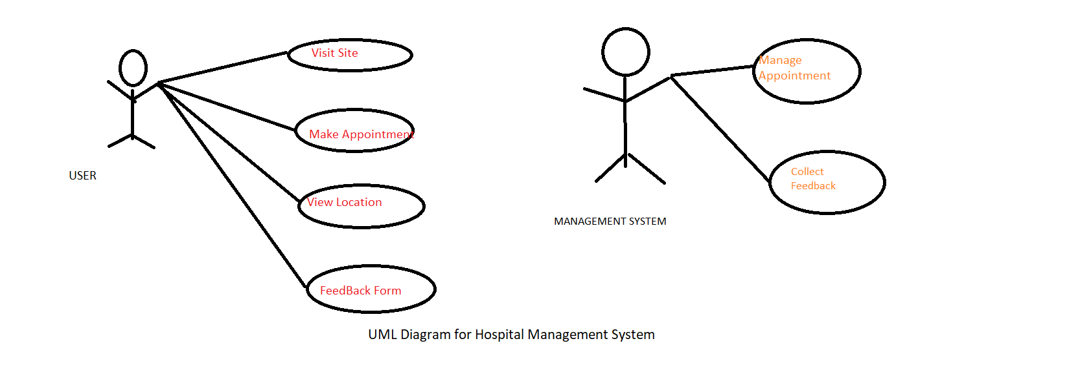
Uml Diagram

Slide 7
Main Feautres
In this Hospital Management , which help us to make an easy appointment in addition it has option to choose a doctor by our choice.
And the other feature is we can search location easily.
In addition ,we can see doctor profiles and their tips.
In this Management feedback form is helpful to develop our hospital.

Slide 8
Advantages
Easy Appointment making.
Easy location.
Check Doctors profile.
User Friendly

Slide 9
Software Requirements
Operating System - Windows 10.
Platform – Eclipse IDE.
Language - HTML,CSS,Javascript.
Files - stylesheet,html.

Slide 10
Conclusion
HOSPITAL MANAGEMENT SYSTEM can be used by any people to search and appoint a doctor easily. Making appointment of multiple people for a big hospital is difficult by using a manual system and may be very time consuming .All these problems are solved by this project.

